Slide 1
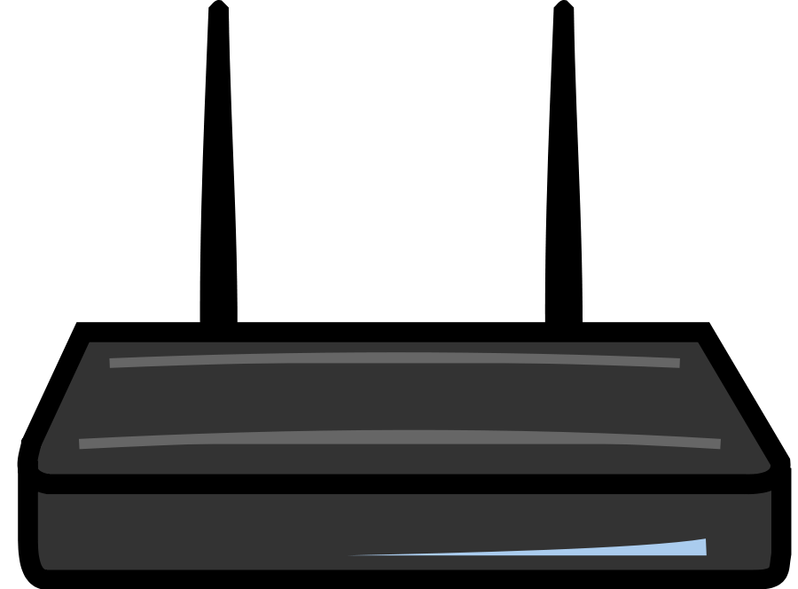

TFMS
Data Manager
Sender
Client
Receiver
Database
Users

